Slide 1
CHARGING UP CHANGE!
HEAD OF DEVELOPMENT
JOB DESCRIPTION & SPECIFICATION
DEADLINE: 10th November 2024 (10.00 HRS)

Slide 2
JOB SUMMARY
HEAD OF DEVELOPMENT
Deadline: 10th November 2023 (10am)
Application Form: https://89d77627055430.uk.deputy.com/jobs#/
ROLE | Head of Development
REPORTING TO | Chief Executive Officer (CEO)
RESPONSIBLE FOR | Development, Income Generation Team and Marketing
SALARY | £28,018 - £34,050
HOURS | 40 hours per week
DURATION OF CONTRACT | 31st March 2026
TIMESCALE | Immediate start
BASED | Powered by CAN HQ – West Bromwich
ROLES AVAILABLE | 1
SUMMARY | Powered by CAN are looking for dynamic Head of Development with Business, Income Generation & Marketing, with at least 3-5 years experience. The role will lead external communication strategies and public affairs alongside leading income and resource generation through development strategies, bidding and relationship building. This role will require intellectual engagement with the content of our work and exceptional relationship building skills, alongside imagination and innovation in approaches to driving transformational change for children, young people and young adults (under 35’s) throughout the Black Country and surrounding areas.
by
Powered by CAN – Recruitment Pack| www.poweredbycan.org

Slide 3
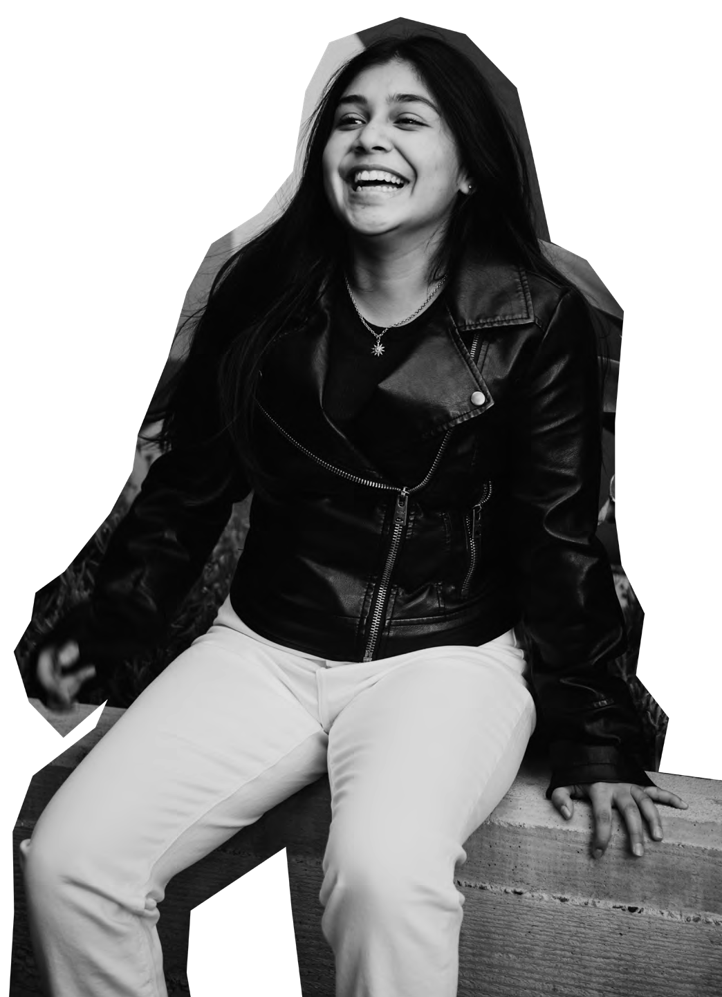
WHO
WE ARE
POWERING CHILDREN, YOUNG PEOPLE
& YOUNG ADULTS TO CHARGE UP CHANGE!
by
Powered by CAN – Recruitment Pack | www.poweredbycan.org

Slide 4
OUR STORY
How we got here….
Powered by CAN works with children, young people and young adults across the Black Country and the wider Midlands region. Powered by CAN was created, built and developed in Sandwell, and we want to empower young people from the region to feel the same pride and purpose for their community as we do.
Children, Young People & Young Adults are at the heart of everything we do, and we make sure that we always put them first by ensuring we always do the following:
Champion their rights to co-design, co-create and co-produce and make their voices heard.
Encourage leadership pathways for their views and voice to be present their local community.
Kick starting personal and professional development through a wider offer of experiences
We believe in providing opportunities for children, young people & young adults and we want to support them to thrive and contribute at every stage of their lives, for a fairer future.
HARNESSING YOUR…
POWER, POTENTIAL, PROGRESS
by
Powered by CAN – Recruitment Pack | www.poweredbycan.org

Slide 5
OUR MISSION
OUR VISION
How we can work together to make a difference…
We want to power up children, young people & young adults to live with pride, purpose and
prepared to make positive life choices.
How we can make the change…
Powering children, young people & young adults to lead the change they want to see through the delivery of services, opportunities & experiences to contribute at every stage of their lives, for a fairer future.
OUR VALUES
These are at the centre of everything we do…
CARE
CHALLENGE
COMMITMENT
COLLABORATION
CREATIVE
COMMUNITY
by
Powered by CAN – Recruitment Pack | www.poweredbycan.org

Slide 6
OUR SERVICES
Celebrating culture & civic responsibility through confidence, creativity & connecting with others…
Promoting positive lifestyles and empowering people through participation…
Navigating the narrative…
Taking the time to talk, tackle & transform into our true selves…
Always aiming high, aspiring to achieve & Accelerating your ambitions …
by
Powered by CAN – Recruitment Pack | www.poweredbycan.org

Slide 7
OUR OBJECTIVES
1
Pride of Place!
To develop collective understanding and knowledge on the identity of place to strength the services that are relevant to meet the needs of children, young people & young adults.
2
Positive Programmes & Principles!
To deliver ambitious and high quality opportunities and experiences for children, young people & young adults to strengthen best practice for the sector to meet soft, hard and transferable skills.
3
Powering Participants & People!
To build on the strengthens and needs of children, young people & young adults to thrive and be resilient into adulthood.
4
Pushing Performance & Policy!
To influence policy and investment to prioritise services for children, young people & young adults.
5
Playing our Part!
To ensure our workforce, volunteers, board, volunteers are dynamic, diverse and driven to be reputable, responsive and represent a rights based approach for people and place.
by
Powered by CAN – Recruitment Pack | www.poweredbycan.org

Slide 8
We are powered both by where we have come from and the positive energy moving forward with a ‘CAN’ do attitude.
We hope everyone we work with will be able to power up change!
CEO - Jerrel Jackson FRSA MIoD MA BA

Slide 9
DUTIES & RESPONSIBILITIES
HEAD OF DEVELOPMENT
Strategic Organisational Development
To collaborate as part the Senior Leadership Team (SLT) to drive Arts Council England’s Investment Principles/Outcomes & Let’s Create Strategy (including other governing/arms length organisations) along with the senior leadership team (SLT) and board of directors (BOD).
To work cohesively within the SLT to expand the breadth of the organisation's projects/services and growth strategy, whilst continuing to develop the local and national prevalence of Powered by CAN through organisational/business planning and programme development for children, young people and young adults.
To be appointed as one of our Dynamism champions for our Arts Council England’s Investment Principles.
To work together with the SLT to drive social value and civic change.
To collaborate with the Youth Management Board (YMB) and Board of Directors (BOD) to develop methodologies that can be used in strategic documents and policies.
To analyse efficiencies for Powered by CAN’s programmes and services, utilising embedded data management systems and supporting Powered by CAN’s team to assess impact of our services, ensuring participant satisfaction drives Powered by CAN’s work.
To support ongoing research, monitoring and impact reporting for funders and stakeholders to support the development of the organisation.
To lead quality assurance frameworks (e.g. ISO - Investors in People, Social Enterprise Mark, Disability Confident Employer Scheme).
by
Powered by CAN – Recruitment Pack | www.poweredbycan.org

Slide 10
DUTIES & RESPONSIBILITIES
Income Generation
To identify and secure investment to support the sustainability of the organisation in it’s delivery and to collaborate with the senior leadership team (SLT) on organisational sustainability, strategy and delivery.
To work in close conjunction with the SLT to analyse financial needs of the organisation.
To oversee market research on sales-led income generating opportunities for the organisation and taking a leading role on new product/service development.
Partnerships and Networking
To maintain a broad range of partnerships, utilising networks and contacts locally, regionally and nationally that supports Powered by CAN’s work with children and young people and young adults and/or methodological practices of asset-based community development and co-creation.
To attend conferences, performances, events and festivals to maintain a strong awareness of current trends for emerging talent and make critical assessments of strategic direction of the organisation.
To co-lead on the development of strategic partnerships to build our reputation and delivery of programmes.
by
Powered by CAN – Recruitment Pack| www.poweredbycan.org

Slide 11
DUTIES & RESPONSIBILITIES
Marketing Strategy, Development and Research Evaluation
To oversee and manage our digital marketing and content sharing strategy and drive our brand development (online and offline) to help increase organisational presence and awareness.
To provide in depth support with our data analytics and report on how this can be improved further and analyse online campaigns on platforms using external analytics. E.g., Google Analytics, Mailchimp.
To liaise with other organisations to drive our marketing and communications to build the contact base and to report on how this can be improved further using data platforms and previous experience/knowledge.
To demonstrate our brand, our impact and our values to ensure they align with those of children, young people and young adults today and ensure this is actioned in our strategic planning.
by
Powered by CAN – Recruitment Pack| www.poweredbycan.org

Slide 12
DUTIES & RESPONSIBILITIES
General Responsibilities
To line manage the Marketing and Development team and support and motivate the team to drive performance.
To represent the organisation within local and regional networks of supporters and stakeholders.
To participate in regular team meetings and supervision meetings.
Attend ideas meetings and contribute to discussions about the future of Powered by CAN.
To identify personal development and training opportunities for self and team & disseminate CDP & training opportunities to Powered by CAN staff.
To contribute ideas that may support the ongoing development of the organisation.
To contribute to the programming and administration of bespoke commissioned services.
To ensure confidentiality within the organisation at all times.
To participate in activities which fall outside of normal working hours as required, e.g. Training, Staff Meetings, Recruitment/Engagement events, fundraising events, etc.
To undertake such other duties and responsibilities of an equivalent nature as may be determined from time to time by SLT.
Equal Opportunities and Safeguarding
To work within the organisation's safeguarding and equal opportunities policies to ensure allocated staff and freelance practitioners/consultants line managed by the role work within the organisation's safeguarding and equal opportunities policies.
To undertake relevant risk assessments before undertaking events/projects/activities for which the role has direct responsibility.
by
Powered by CAN – Recruitment Pack| www.poweredbycan.org

Slide 13
PERSON SPECIFICATION
HEAD OF DEVELOPMENT
Essential
A minimum of 3-5 years in a similar role with the Cultural, Creative, Education and Youth sectors, with a working knowledge of the Black Country and surrounding areas (including knowledge of marginalised communities).
A keen and active interest in the vision and purpose of Powered by CAN and experience of working in a busy office environment while managing conflicting priorities/multiple projects to meeting deadlines.
To demonstrate a track record of organisational development.
To have an understanding of equal opportunities and cultural diversity issues in the delivery of our services and a commitment to the provision of inclusive activities for children, young people and young adults with an awareness of Child Protection guidelines and relevant legislation.
Demonstrate energy in all that you do and display a ‘can-do’ attitude, with a positive approach to learning & gaining new skills through teamwork and training opportunities.
Patience, punctuality, reliability and trustworthiness.
Desirable
Be in possession of a related Certificate, Diploma or Degree n the Cultural, Creative, Education and Youth contexts.
Experience or knowledge of youth work and/or previous experience of working within a youth-led organisation, especially from safeguarding perspective.
Experience of direct customer service.
Working knowledge of video editing software/apps and a working knowledge of relevant software packages (Microsoft Office Suite, Google).
by
Powered by CAN – Recruitment Pack| www.poweredbycan.org

Slide 14
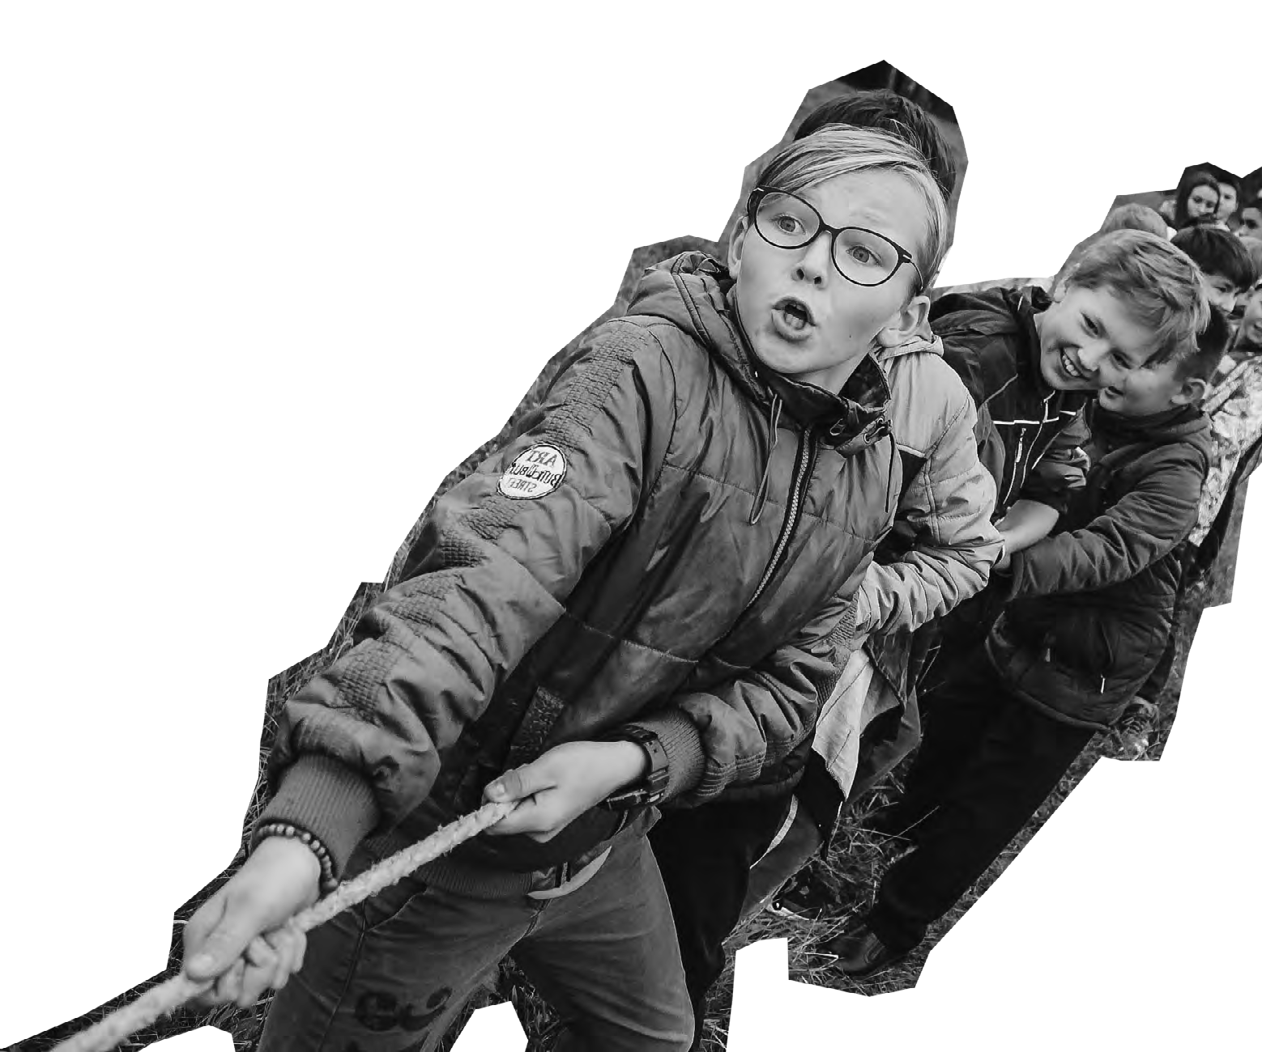
by
FURTHER INFORMATION
Deadline: 10th November 2024 (10.00am)
Application Form: https://89d77627055430.uk.deputy.com/jobs#/
Application Process:
Stage 1 – Informal 30 minute online conversation
Stage 2 – Formal Interview (including Presentation or Practical) Contact Information:
jobs@poweredbycan.org or 0121 530 8451
DBS and Reference
This role is subject to a clear enhanced DBS and satisfactory
Employment/Character references.
Please note we are currently using a new application system,
so if you face any technical difficulties please email jobs@poweredbycan.org

